Slide 1
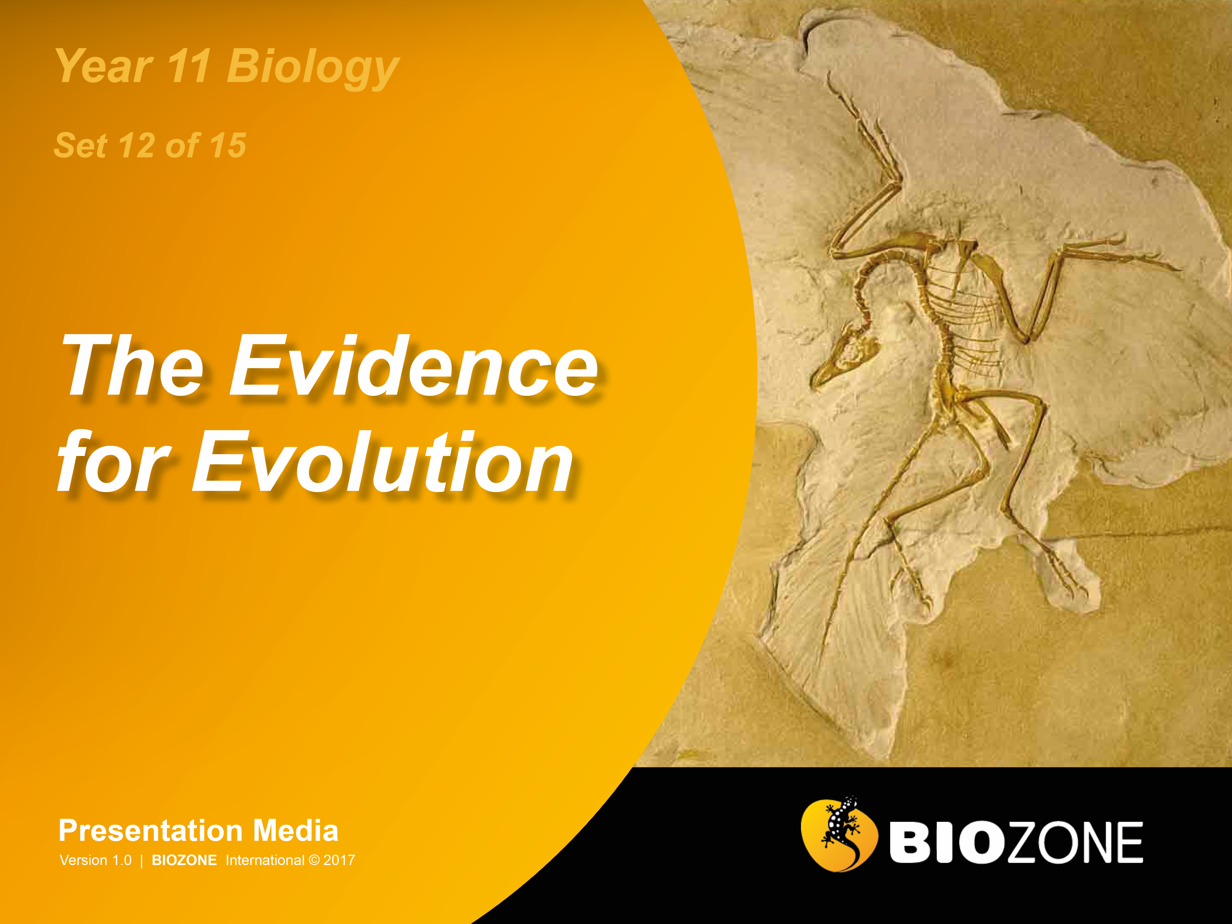

Slide 2
Evidence for Evolution
  What is Evolution?
  Evidence for Evolution
  DNA Hybidisation
  Amino Acid Sequencing
  Immunological Evidence
  The Molecular Clock
  Comparative Anatomy
  Fossil Evidence
  Continental Drift
  Biogeographical Evidence

Slide 3
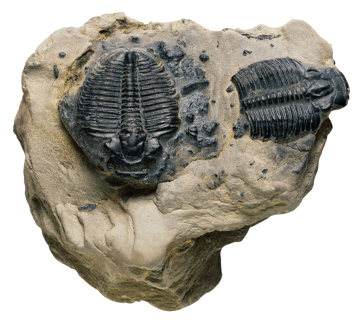
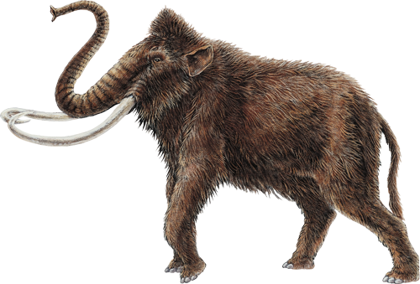
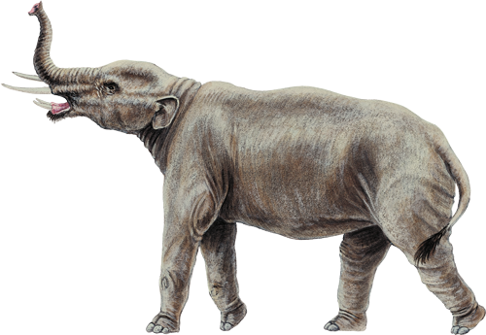
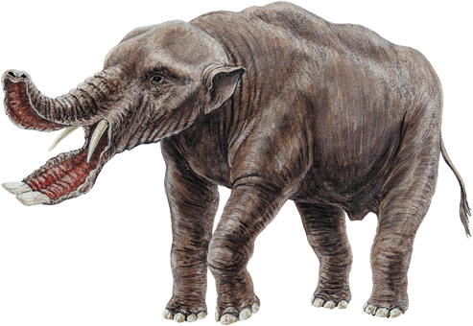
What is Evolution?
Evolution is described as the heritable genetic changes seen
in a population over time.
  Evolution refers to populations,
  not individuals.
  The changes are passed onto the next generation (they are inherited).
Microevolution describes the
small-scale changes within
gene pools over generations.
Macroevolution is the term used to describe large scale changes in form, as viewed in the fossil record, involving whole groups of species
and genera.
Photo: PD

Slide 4
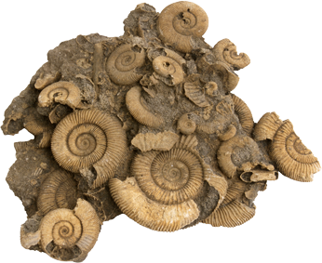
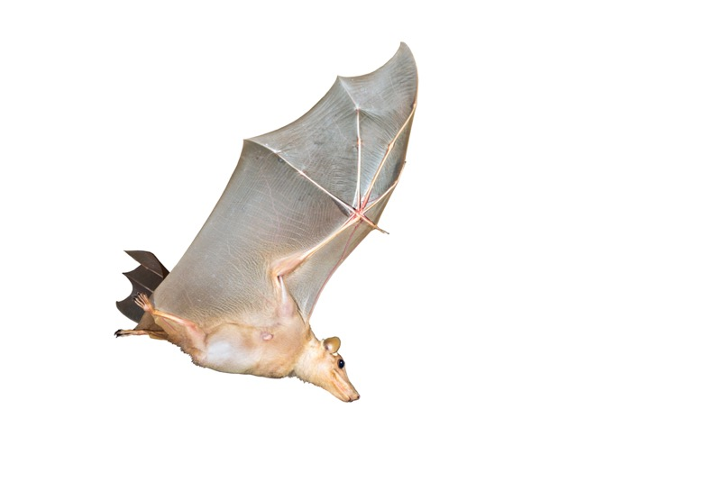

Evidence for Evolution
Evolutionary theory is now supported by a wealth of observations and experiments.
The fact that evolution occurs is well documented, although biologists may not always agree on the mechanisms by which populations evolve.
Evidence for evolution comes from
many sources:
  Palaeontology: The identification,
  interpretation and dating of fossils
  gives us some of the most direct
  evidence of evolution.
  Embryology and evolutionary
  developmental biology (evo-devo):
  The study of embryonic development in
  different organisms and its genetic control.
  Comparative anatomy:
  The study of the morphology
  of different species.
Photo: PO
Paleontology
Photo: iStock
Comparative anatomy

Slide 5
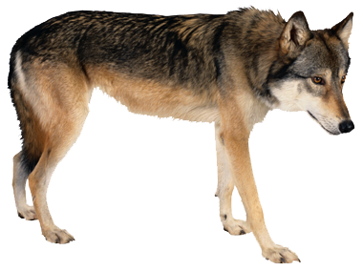
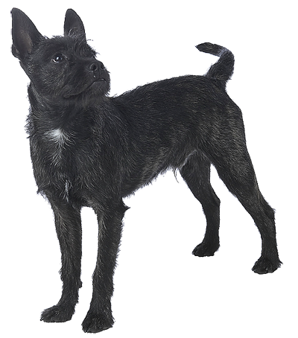
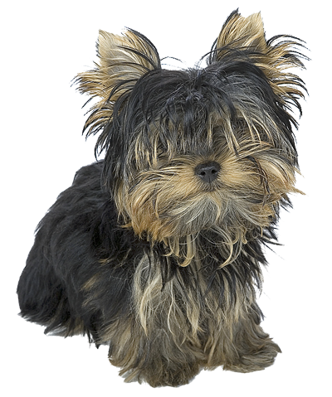
Evidence for Evolution
  Biogeography: The study of geographic distributions can indicate where species may have originally arisen.
  Artificial selection: Selective breeding of plants and animals has shown that the phenotypic characteristics of species can change over generations as particular traits are selected in offspring.
  Biochemistry: Similarities and differences
  in the biochemical make-up of organisms
  can closely parallel similarities and differences in appearance.
  Molecular genetics: Sequencing of DNA and proteins indicates the degree
  of relatedness between organisms.
From grey wolf to Yorkshire terrier: selective breeding can result in phenotypic change
All photos: PD

Slide 6
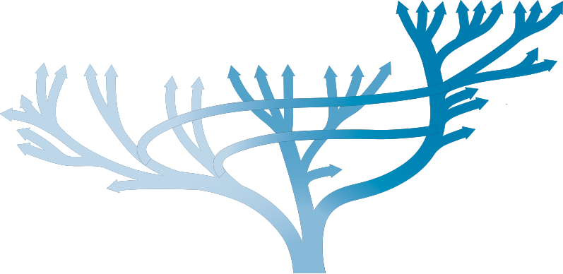
Decent and Common Ancestry
Molecular phylogenetics has enabled scientists to clarify the very earliest origins of eukaryotes and to recognise two prokaryote domains.
Powerful evidence for the common ancestry of all life comes from the commonality in the genetic code, and from the similarities in the molecular machinery of all cells.
Archaea
Animals
Fungi
Plants
Methanogens, extreme thermophiles, halobacteria
Cyanobacteria
Sulfobacteria
Algae
Other bacteria
Proteobacteria
Ciliates
Eukarya
Other single celled eukaryotes
Hyperthermophillic bacteria
Bacteria that gave rise to chloroplasts
Bacteria
Bacteria that gave rise to mitochondria
Last Universal Common Ancestor (LUCA)

Slide 7
Common Themes
All living systems share certain cellular mechanisms and features:
In all living systems, the genetic machinery consists of self-replicating DNA molecules. Some DNA is transcribed into RNA, some of which is translated into proteins. The machinery for translation (above) involves proteins and RNA. Ribosomal RNA analyses support a universal common ancestor.
The endosymbiotic origin of eukaryotic mitochondria is supported by the evidence from mitochondrial gene sequences, ribosomes, and protein synthesis that indicate a prokaryotic origin. Mitochondria are characteristic of eukaryotic cells and arose in a common ancestor to eukaryotic cells.
Chloroplasts are assumed to have been acquired, via endosymbiosis, after mitochondria and there is much evidence to suggest that they were acquired independently by more than one type of cyanobacterial cell (i.e. their origin is polyphyletic). The prokaryotic origin of chloroplasts is supported by ribosomal evidence.
Most organisms share the same genetic code, i.e. the same combination of three DNA bases code for the same amino acid, although there are some minor variations (e.g. in mitochondria). Evidence suggests the code was subject to selection pressure which acted to minimise the effect of point mutations or errors in translation.

Slide 8
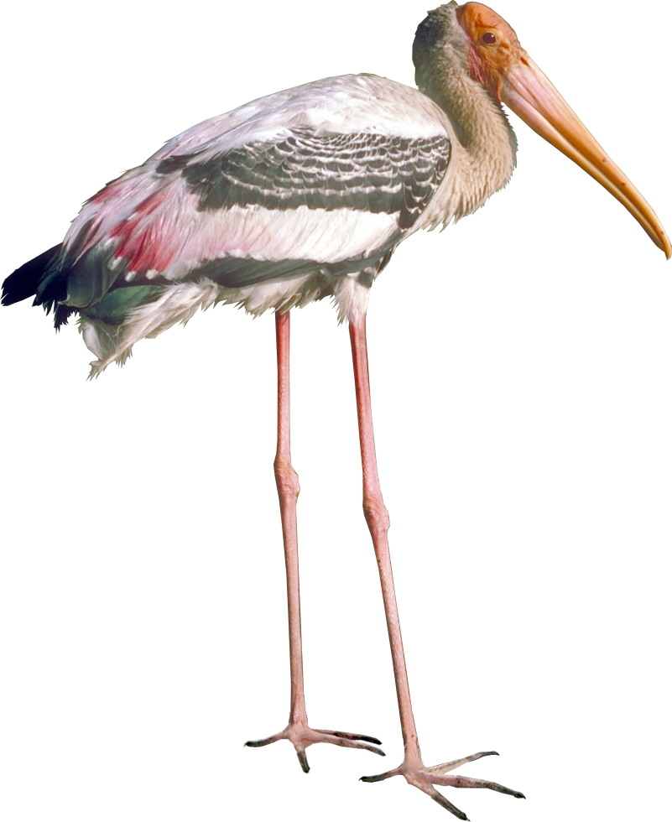
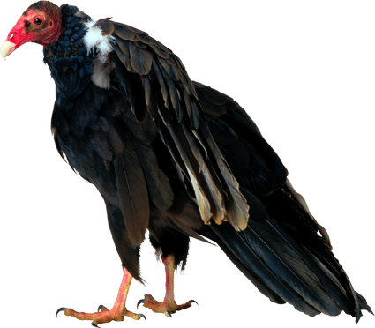
DNA Hybridisation
One way to reconstruct the evolutionary history of a species is using DNA hybridisation.
  In this technique, the DNA from different species is ‘unzipped’ and recombined to form hybrid DNA.
  Heat can be used to separate the hybridised strands. The amount of heat required to do this is a measure of how similar the two DNA strands are (% bonding).
Example:
  The relationships among the New World vultures and storks has been determined on the basis of DNA hybridisation.
Stork
New World vulture

Slide 9
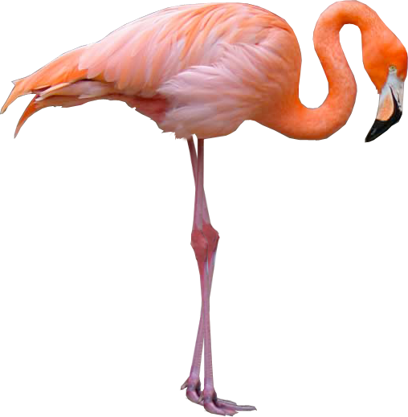
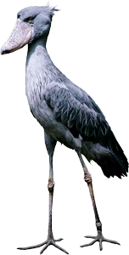
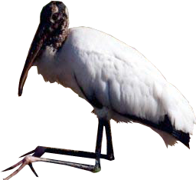
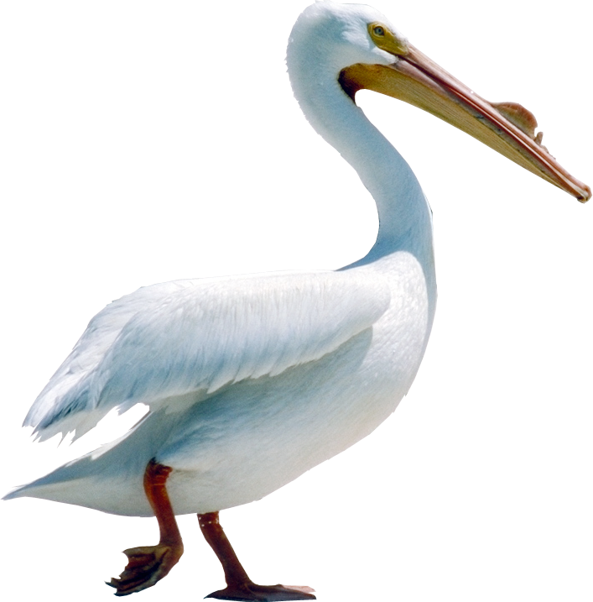
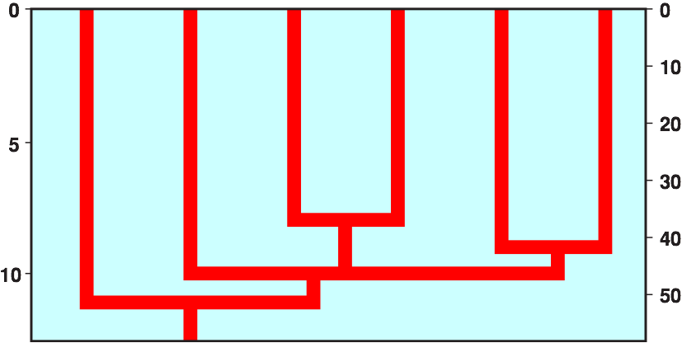
DNA Hybridisation
New World vulture
Flamingo
Ibis
Shoebill
Pelican
Stork
DNA Difference Score
Millions of years ago

Slide 10

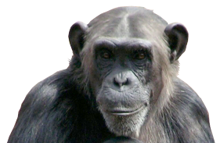




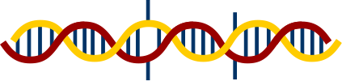
DNA Hybridisation Method
DNA is isolated from blood samples from each species:
  The greater the similarity in the DNA base sequences, the stronger the attraction between the two strands and the harder it is to separate them again.
  A crude measure of DNA relatedness can be achieved by measuring how hard it is to separate the hybrid DNA.
  This is done by finding the temperature at which it unzips into single strands again (in this case it would be 83.6°C).
Extract human DNA
Photo: CA
Photo: iStock
Extract chimpanzee DNA
Unzip the DNA using heat (both human and chimpanzee DNA unwinds at 86°C)
Mix strands to
form a hybrid
Some of the opposing bases in the DNA sequence do not match. Separation temperature of hybrid strand is 83.6°C.

Slide 11
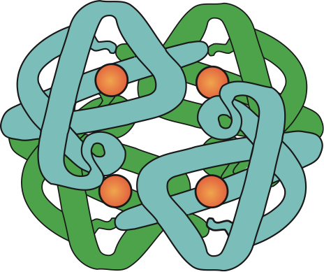
Amino Acid Sequencing
Glu
Tyr
The sequences of amino acids in certain proteins (e.g. haemoglobin and cytochrome C) have revealed great similarities and specific differences between species.
Closely related species have proteins
with similar amino acid sequences.
Amino acid sequences are determined
by inherited genes and differences are
due to mutations.
The degree of similarity of these proteins is determined by the number of mutations that have occurred. Distantly related species have had more time for differences to accumulate:
  The greater the elapsed time since common ancestry, the greater the time for mutations to occur.
  This in turn leads to a greater difference in amino acid sequences between species.
Phe
Ser
Iso
Ala
Phe
Ala
Glu
Ala
Met
Gly
Amino acids
Haemoglobin

Slide 12
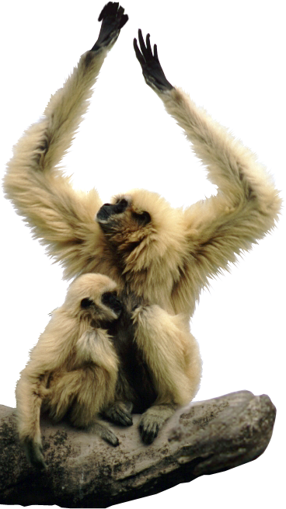
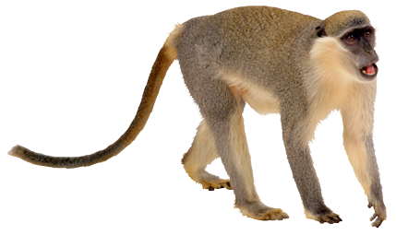
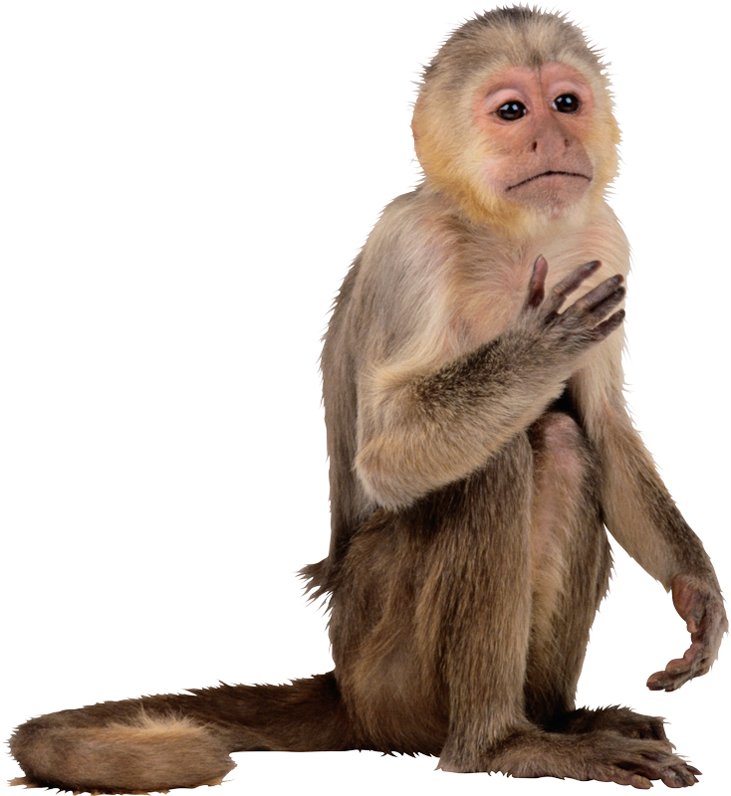
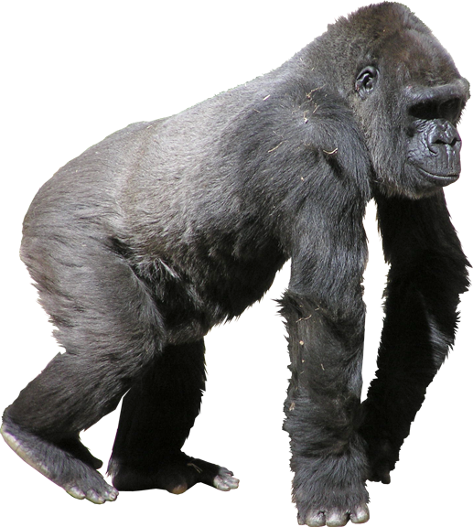
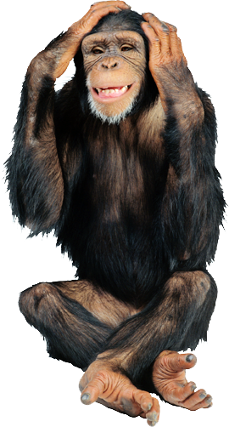
Amino Acid Sequencing
Squirrel monkey
Gibbon
Amino acid differences for beta-haemoglobin in primates compared to the human sequence:
Photo: PD
Rhesus monkey
Primate | No. of amino acids different from humans | Position of changed amino acids
Chimpanzee | Identical | –
Gorilla | 1 | 104
Gibbon | 3 | 80 87 125
Rhesus monkey | 8 | 9 13 33 50 76 87 104 125
Squirrel monkey | 9 | 5 6 9 21 22 56 76 87 125
Gorilla
Chimpanzee
Photo: PD
The 'position of changed amino acids' is the point in the protein, composed of 146 amino acids, at which a different amino acid occurs.

Slide 13
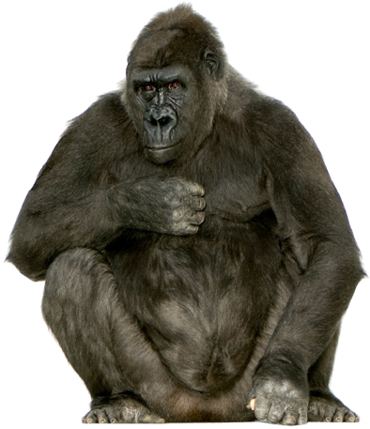

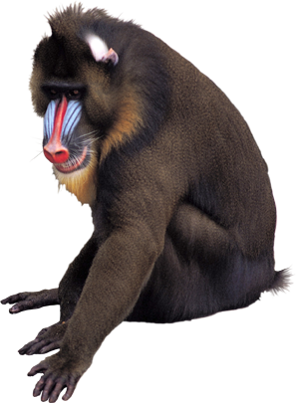
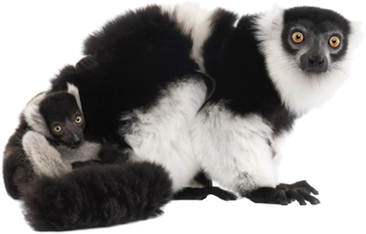
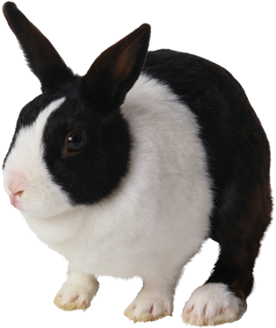
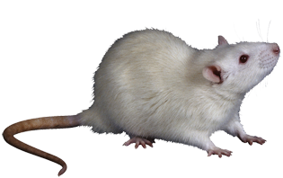
Immunological Techniques
Immunology indirectly measures the degree of similarity of proteins in different species.
  Example: Anti-human antibodies are developed in a rabbit and added to the blood of other species.
  The greater the similarity between humans and the blood of other species the greater the antibody-antigen reaction.
Photo: iStock
Gorilla
Baboon
Photo: PC
Decreasing similarity with human blood
Lemur
Photo: PD
Photo: iStock
Rat
Rabbit

Slide 14
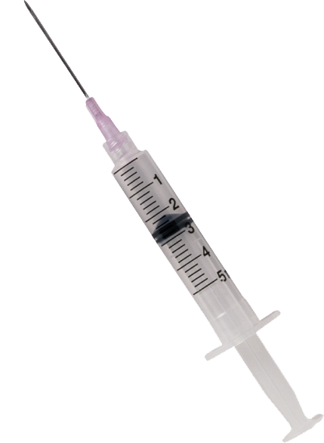

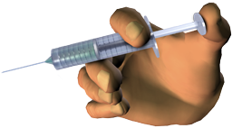
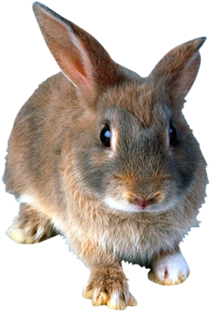
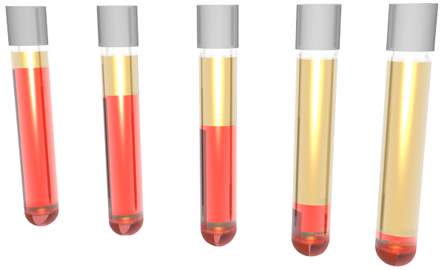
Immunological Studies
Human serum
injected into rabbit
Method for Immunological Comparison
Human blood serum (containing blood proteins but no cells) is injected into
a rabbit. The rabbit forms antibodies that identify the human blood proteins, attach to them, and render
them harmless.
A sample of the rabbit's blood is taken and the antibodies are extracted.
These anti-human antibodies are added to blood samples from other species to see how well they recognise the proteins in the blood of different species. The more similar the blood to human blood, the greater the reaction (which takes the form of creating a precipitate, i.e. solids).
Rabbit serum with anti-human antibodies extracted
Rabbit serum added to blood of other species
Precipitate forms
Human
Gorilla
Baboon
Lemur
Rat
Decreasing recognition of anti-human antibodies to blood proteins
The five blood samples tested (above) show varying degrees of precipitate (solid) formation. When the anti-human antibodies are added to human blood there is a high degree of affinity. There is poor recognition when added to rat blood.

Slide 15
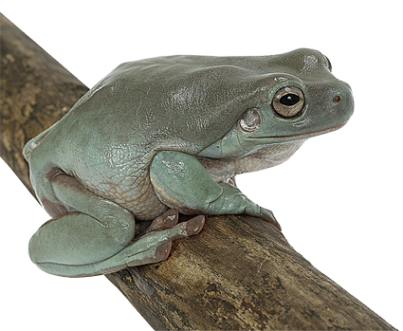
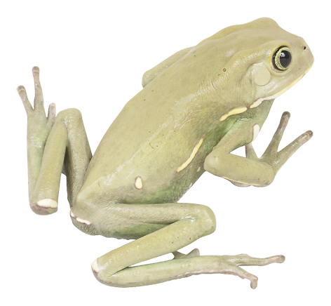
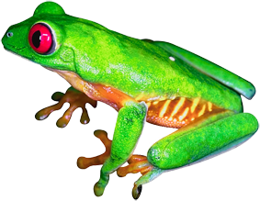
Immunological Evidence
The evolutionary relationships of a large number of different animal groups have been established on the basis of immunology.
The results support the phylogenies developed from other areas of biology: biogeography, comparative anatomy, morphological studies, and fossil evidence.
Example: relatedness of tree frogs.
  The phylogeny (evolutionary relationships) of tree frogs has been established by immunology.
  The immunological distance is the number of amino acid substitutions between taxa.
Photo: Hemera

Slide 16
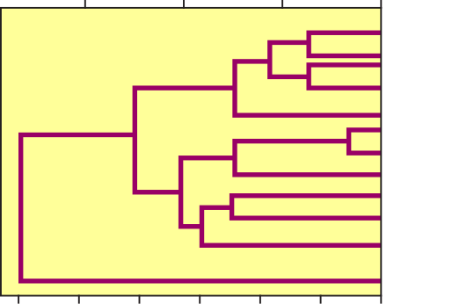
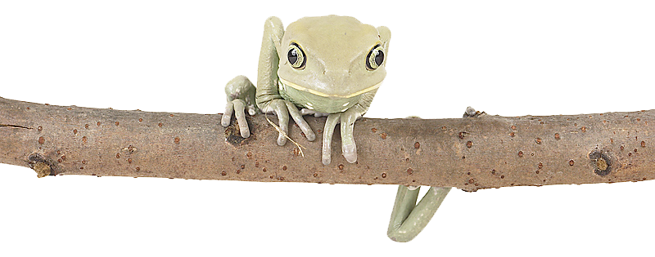
Immunological Studies
The relationships among tree frogs have been established
by immunological studies.
  The immunological distance is
  a measure of the number of
  amino acid substitutions between
  two groups.
  This, in turn, has been calibrated to produce a time scale showing when the various related groups diverged.
Immunological comparison of tree frogs
Millions of years ago
30
20
10
0
North American tree frogs
European tree frogs
Cricket frog
Chorus frogs
Australian tree frog
60
50
40
30
20
10
0
Immunological distance

Slide 17
The Molecular Clock
The molecular clock hypothesis states that mutations occur at a relatively constant rate for any given gene.
The genetic difference between any two species can indicate when two species last shared a common ancestor and can be used to construct a phylogenetic tree.
The molecular clock for each species, and each protein, may run at different rates, so molecular clock data is calibrated with other evidence (e.g. morphological) to confirm phylogeny.
Molecular clock calculations are carried out on DNA or amino acid sequences.
Time 0
Time + 25 million years
1 mutation
Time + 50 million years
2 mutations
CAATTGATCG
CAATCGATCG
Common ancestor
CAATTTATCG
CAATTTATCT
CAATTTATTT

Slide 18
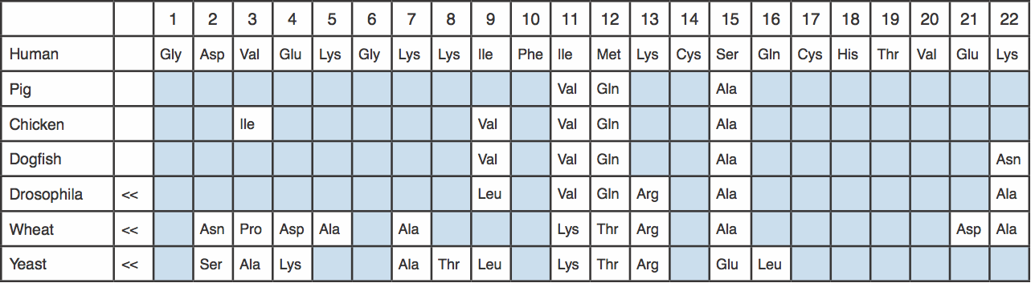
Cytochrome C
The table below shows the N-terminal 22 amino acid residues of human cytochrome c, with corresponding sequences from other organisms aligned beneath.
Sequences are aligned to give the most position matches.
A shaded square indicates no change.
In every case, the cytochrome's heme group is attached to the Cys-14 and Cys-17.
In Drosophila, wheat, and yeast, arrows indicate that several amino acids precede the sequence shown.

Slide 19
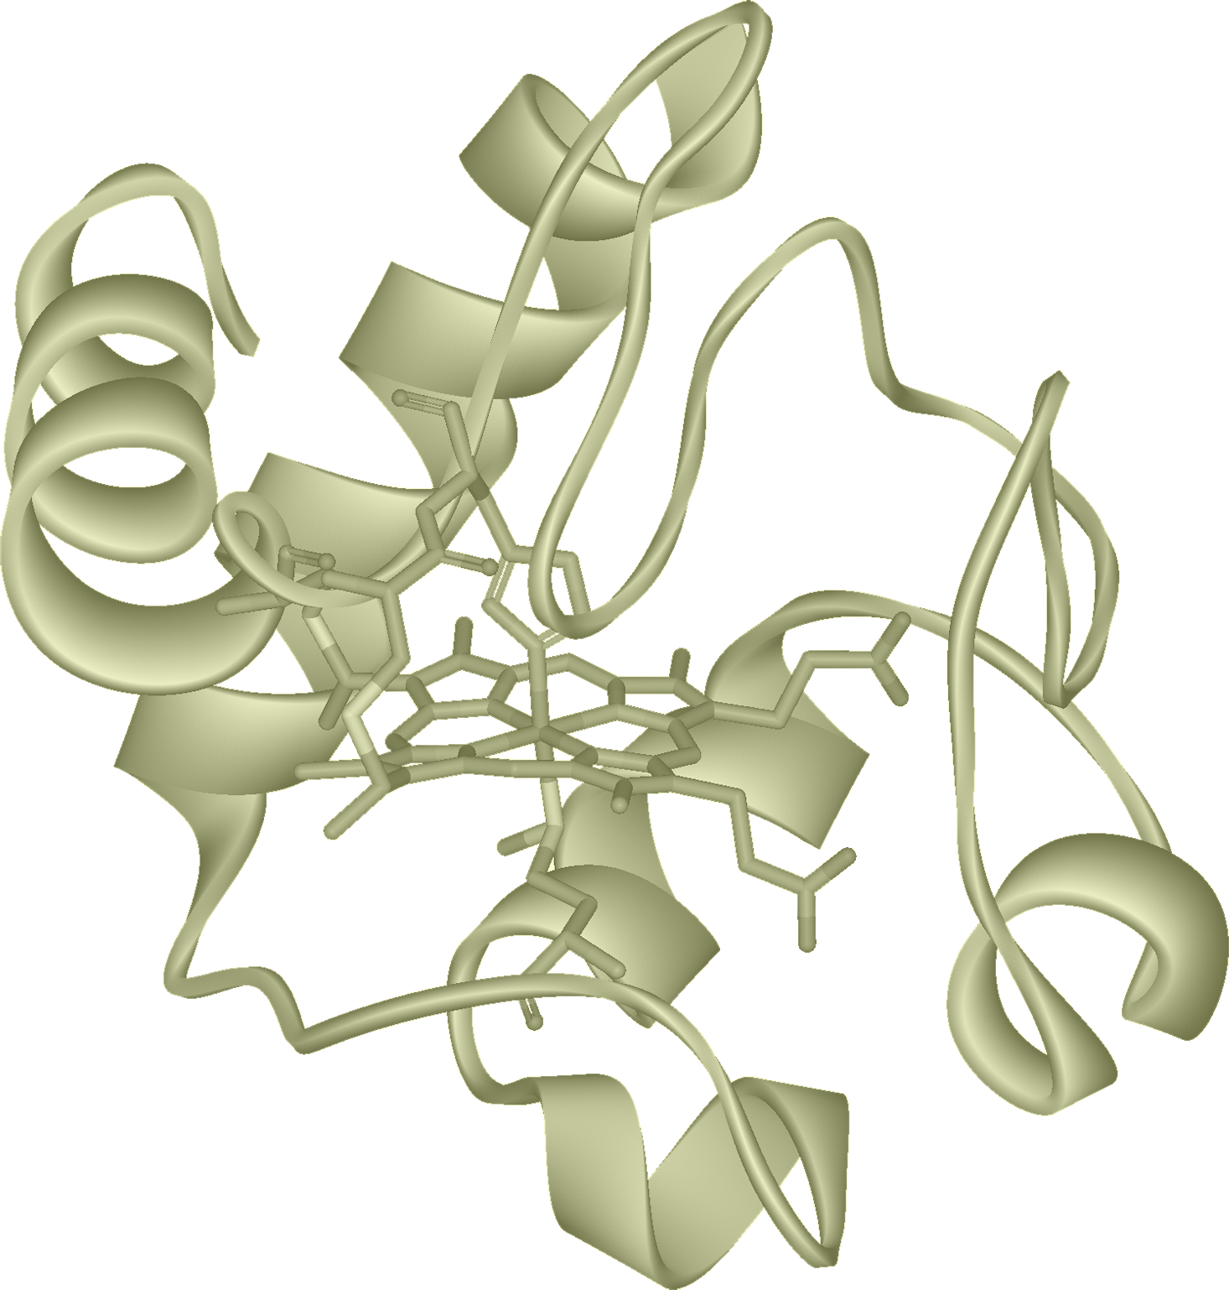
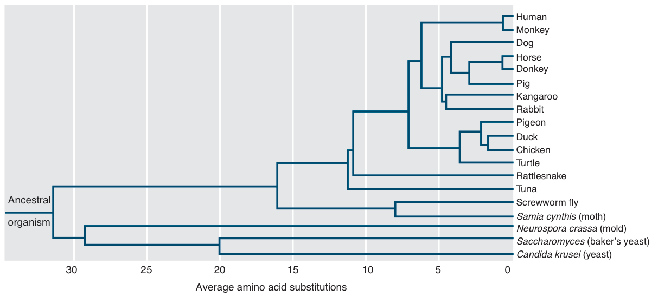
Homology of Cytochrome C
The sequence homology of cytochrome c, a respiratory protein, has been used to construct a phylogenetic tree for some species.
  Overall, the phylogeny aligns well to other evolutionary data, although the tree indicates that primates branched off before the marsupials diverged from other placental mammals, which is incorrect based on other evidence.
  Highly conserved proteins, such as cytochrome c, change very little over time or between species because they have critical roles and if they changed too much they may no longer function properly.
Cytochrome c

Slide 20
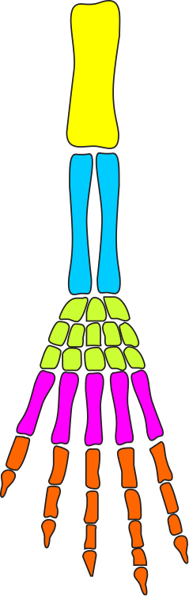
Comparative Anatomy
The pentadactyl (5 digit) limb found in most vertebrates has the same general bone structure.
This similarity of structure is called homology.
Homologies are indicative of common ancestry.
Forelimb
Hind limb
Humerus
(upper arm)
Femur (thigh)
Ulna
Fibula
Radius
Tibia
Carpals
(wrist)
Tarsals
(ankle)
Metacarpals
(palm)
Metatarsals
(sole)
Phalanges
(fingers)
Phalanges
(toes)
  Note that forelimbs and hind limbs have different names for equivalent bones.

Slide 21
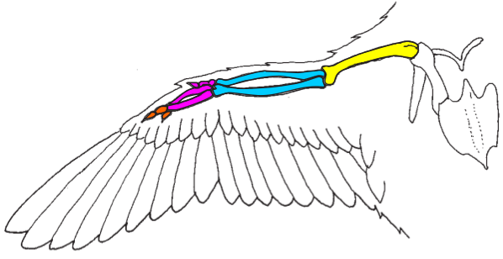
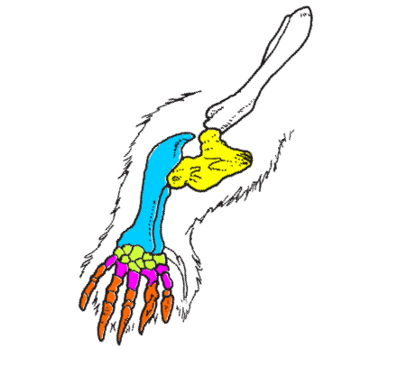
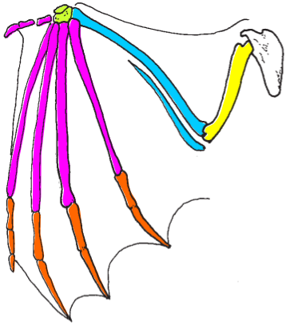
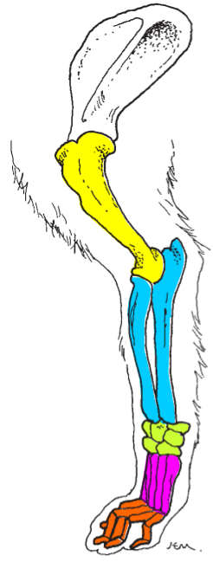
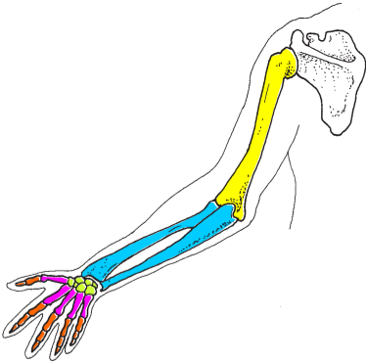
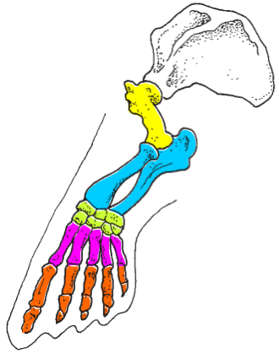
Homologous Structures
In many vertebrates, the basic pentadactyl limb has been highly modified to serve specialised locomotory functions.
Such homologies also indicate adaptive radiation, as the basic limb plan has been adapted to meet the needs of different niches.
The same pattern of bones making up the pentadactyl limb can be seen on each of these examples.
Bird's wing
Mole's forelimb
Dog's front leg
Bat's wing
Seal's flipper
Human arm

Slide 22


Developmental Evidence
Similarities in the development of embryos, including the genetic control of that development, provides strong evidence for evolution.
Developmental biology focuses on the genetic control of development and its role in producing the large differences we see in the adult appearance of different species.
Differences in gene expression during development are behind
these differences.
Mouse embryo 12 days
Human embryo 7 weeks
Matthias Zepper
During development, vertebrate embryos pass through the same stages, in the same sequence, regardless of the total time period of development. This similarity is strong evidence of their shared ancestry. The stage of embryonic development is identified using a standardised system based on the development of structures, not by size or the number of days of development.

Slide 23
Horse
Evolution
Equus
Present
The evolution of the horse
is well documented in the
fossil record.
  There are many transitional
  fossils which have allowed scientists to build a robust model of of horse phylogeny.
  There are many divergences
  and a diverse array of species once coexisted.
  The ancestry of the horse can
  be traced back to Hyracotherium (Eohippus) 55 mya.
Pliohippus
5 mya
Merychippus
16 mya
Mesohippus
30 mya
Image: H Zell CC.3.0

Slide 24



Biogeographical Evidence
Lemurs are endemic to the island of Madagascar
The study of plant and animal distribution is called biogeography.
  The basic principle of biogeography is that each plant and animal species originated only once. The place where this occurred is the centre of origin.
  The range of a species can be very restricted or, as with humans, almost the whole world (cosmopolitan).
  Regions that have been separated from the rest of the world for a long time (e.g. Madagascar, Australia, and New Zealand), often have distinctive biota comprising a large number of endemic species (species that are found nowhere else).
Map: University of Texas at Austin (Public Domain image)

Slide 25


Biogeographical Evidence
General principles for the dispersal and distribution of land animals are:
  Closely related animals in different geographic areas probably had no barrier to dispersal in
  the past.
  The most effective barrier to dispersal in land animals is sea (as when sea levels change).
  The discontinuous distribution of modern species may be explained by movement out of the area they originally occupied, or by extinction.
Oceanic islands often have species that are similar to, but distinct from, those on neighbouring continents.
The occurrence of these species suggests that they were island colonisers that evolved in isolation differently to their ancestors on the mainland.
Stag beetles

Slide 26



Biogeographical
Distribution
The distribution of species around the world suggests that modern forms evolved from ancestral populations and spread (radiated) out into new environments.
Good examples are found on islands offshore from large continental land masses:
  Galápagos Islands
  Cape Verde Islands
  Tristan da Cunha

Slide 27


Galápagos Islands
The Galápagos Islands have species very similar to, but distinct from, the South American mainland.
Ancestral forms would have migrated to the islands from South America in the past.
The giant tortoises are among the most well known of the Galapagos fauna

Slide 28


Cape Verde Islands
Species on the Cape Verde Islands have close relatives on the West Africa mainland.
There are relatively few animals and no indigenous mammals.
Ospreys are one of the more common birds on the Cape Verde Islands

Slide 29

The Biogeography of
Tristan da Cunha
The island of Tristan da Cunha,
in the South Atlantic Ocean,
provides good evidence of the
evolution of new species from
ancestral ones.
  Plant species on the island are of
  either South American origin, African
  origin, or both (universal origin).
  Despite the fact that Africa is considerably closer, more species show South American affinities than African ones.
  This is probably due to the predominant westerly trade winds from the direction of South America.

Slide 30
The Biogeography of
Tristan da Cunha
South American origin
7 Flowering Plants
5 Ferns
30 Liverworts
African origin
2 Flowering Plants
2 Ferns
5 Liverworts
Universal origin
19 Flowering Plants

Slide 31

Island Colonisers
Species may reach offshore islands (new habitat) in a number of ways:
  Flight, rafting across water, being passively blown by prevailing winds.
  Species with the ability for strong prolonged flight, such as seabirds, are not easily isolated in one area and are often widespread (cosmopolitan) in their distribution.
  Mobile terrestrial species may be isolated by changes in the environment caused by major geological events (e.g. volcanic activity, sea level rise).
  Many species that become permanently isolated on offshore islands have low mobility and weak powers of dispersal.

Slide 32

Island Colonisers
Colonisers may be blown to an island by the prevailing wind and be unable to return (e.g. bats, small birds, insects).
Other animals may be good colonisers because they can survive periods of food and water deprivation while making the journey to the island by sea (e.g. reptiles).
Successful colonisers of islands are often highly adaptable in their food and
habitat requirements.
In the new environment, species may later become more specialised
as they exploit a new range of resources.

Slide 33

Island Colonisers
Land mammals rarely colonise islands. A high metabolic rate requires much food and water. Mammals cannot sustain themselves on long sea journeys.
Blown by strong winds
Small birds, bats, and insects are blown to islands by accident. They must adapt to life there or perish.
Reptiles probably reach distant islands by floating in driftwood. A low metabolic rate enables them to survive long periods without food and water.
Active flight
Seabirds fly to and from islands with relative ease. Some adapt to life on land, (e.g. the flightless cormorant in the Galápagos Islands). Others, may treat the island as a stopping place (e.g. the frigate bird).
Oceanic island
Sea mammals have little difficulty in reaching islands (e.g. seals, sea lions). They do not colonise the interior of islands.
Rafting on
drifting vegetation
Planktonic larvae
Swimming
Amphibians cannot live away from fresh water. They seldom reach offshore islands unless that island is a continental remnant.
Crustacean larvae drift to islands (e.g. crabs). Some crabs have adapted to an island niche.
Deep ocean

Slide 34

The Fossil Record
The fossil record is an orderly array in which fossils appear in the layers, or strata, of sedimentary rocks.
When organisms are trapped in sediments, they record that moment in time.
  The fossils in each stratum of sedimentary rock are a local sample of the organisms that existed at the time the sediment was deposited.
  Because younger sediments overlie older
  ones, it is possible to determine the relative ages of fossils.
This perfectly preserved skeleton of Archaeopteryx includes impressions of feathers on the forelimbs and tail

Slide 35



Fossils
Fossils are the remains of long-dead organisms that have become preserved in the Earth’s crust. They provide a record of the appearance and extinction of organisms.
  Fossils form best when organisms are buried quickly in conditions that slow the process of decay.
  Fossils are most commonly found in sedimentary rock.
  Mineral-rich hard parts (bones, teeth, shells) may remain as fossils. Minerals, dissolved in water, may seep into tissues and replace the organic matter of the organism.
  On rare occasions, fossils retain organic material, as when plant material is compressed between layers of shale or sandstone.
Fossil fish
PO
A layer of shell still covers the stone interior of this ammonite
PO
Bird bones preserved in a tar pit
RA

Slide 36







Fossils in a Rock Profile
Recent fossils are found in recent sediments
Layers of sedimentary rock are arranged in the order in which they were deposited, with the most recent layers nearer the surface.
  Sedimentary layers can be disturbed by subsequent tectonic activity.
The interpretation of rock layers containing fossils allows us to arrange the fossils in chronological order (order of occurrence), but does not give their absolute date.
Youngest sediments
Numerous extinct species
Fossil types differ in each sedimentary rock layer
New fossil types mark changes in environment
Oldest sediments
Only primitive fossils are found in older sediments

Slide 37



Continental Drift 1
Late Palaeozoic
The movement of continents moved whole assemblages of plants and animals across the surface of the Earth.
As well as creating geographical barriers in the form of oceans, it brought new combinations of species together.
250 million years ago
The continents formed a single landmass; dinosaurs and mammal ancestors roamed the earth.
Turgai Strait
Palaeocene – Mid Eocene
65-46 million years ago
Most continents were separated, North America and Europe joined;
Mammals underwent adaptive radiation into many forms.
Late Eocene
46-38 million years ago
Europe split away from North America and joined Asia. India was still an island, with South America joined to Antarctica.

Slide 38





Continental Drift 2
A map of the present day world showing the evidence for how present-day lands once made up the supercontinent of Gondwana.
North America
Europe
Asia
Africa
India
New Guinea
Madagascar
South America
Australia
Direction of ice sheet movement 350-230 mya
Geomagnetic pole direction 150 million years ago
Distribution of Lystrosaurus
New Zealand
Distribution of Glossopteris
Old Precambrian (> 650 mya)
Precambrian (650-570 mya)
Early Paleozoic (570-350 mya)
Paleozoic-Mesozoic (350-160 mya)
Late Mesozoic (160-70 mya)
Antarctica

Slide 39

Continental Drift 3
The continents and islands that once comprised Gondwana may be fitted together to form a single landmass.
Gondwana supercontinent coastline about 250-150 million years ago
Africa
South Pole 350-230 million years ago
Madagascar
South America
India
Antarctica
New Guinea
Australia
Geomagnetic South Pole 150 million years ago
+
New Zealand
New Caledonia

Slide 40


Slide 41
Conditions of Use
  NOTE: Presentation Media = presentations available on CD-ROM/DVD-ROM or as downloads
  BIOZONE retains copyright to the intellectual property included in the Presentation Media files, with acknowledgement that certain photos are used under license and are credited appropriately.
  You MAY:
Use the Presentation Media files for presentations in your classrooms using a data projector, interactive whiteboard or overhead projector.
Place the Presentation Media files on any staff computer within the school, including staff laptops, but not in contradiction to clause (g).
Place the Presentation Media files on:
  The school’s intranet (school computer network)
  VLE (Virtual Learning Environment)
  A CMS (Content Management System).
Student and staff access must be restricted to those who are enrolled/working on the campus of the registered purchaser. Student and staff access to a VLE or a CMS must be controlled by a user login and password protocol, but not in contradiction to clause (f). If students have access, they need to be made aware of the Conditions of Use and are only allowed to view the content.
Edit and customise the Presentation Media files by adding, deleting, and modifying information to better suit your needs, but not in contradiction to clauses 2 (c) - (d).
Print out the Presentation Media files in PowerPoint® or Keynote® “Handouts” mode for the express purpose of allowing students to make their own notes about the presentation, but not in contradiction to clause (e).
You MAY NOT:
Place the Presentation Media files on to the Internet or on a service that may be accessed off-campus unless access to the service is protected by a user login and password protocol, and is restricted to students and staff enrolled/working on the campus of the registered purchaser.
Place the Presentation Media files on student laptop computers.
REMOVE any of the references to BIOZONE, the title slides, copyright notices, photo credits, or Conditions of Use from the Presentation Media files.
Create a NEW document using any of the graphics/images in the Presentation Media files.
Print the Presentation Media files on to paper to make your own worksheets for distribution to students.
Incorporate any part of the Presentation Media files for the production of another commercial product.
Share or give away any content off-campus. This prohibition apples to, but is not limited to, sharing via the Internet or any website, (examples: YouTube, slide sharing websites).
Conditions of Use are subject to change without notice. Visit http://www.biozone.com.au/faqconditionsofuse/

Slide 42
Photo Credits
Photographic images are used under license from the following commercial photo libraries:
  Corel Corporation Professional Photos (uncoded)
  ArtToday.com (coded AT)
  Clipart.com (coded CA)
  PhotoObjects.com (coded PO)
  iStock.com (coded iStock)
  Hemera Technologies Inc. (coded Hemera)
  Photos.com (coded PC)
  Education interactive (coded EII)
  Digital Stock (coded DS)
  LifeArt (coded LA)
  Dollar Photo Club (coded DPC)
3D models were created using Poser
Additional artwork and photographs are the property of BIOZONE International Ltd. All rights reserved.
Some 2D artwork has been adapted from TechPool STUDIOS LifeArt Collections, used under licence.
Images from the Public Domain: Where these licenses have been used, authors and licenses have been acknowledged alongside their image.
    Centers for Disease Control (coded CDC)
    National Institutes of Health (coded NIH)
    National Aeronautics and Space Administration (NASA)
    Images from the public domain include limited copyright,
    copyright expired, uncopyrighted, or uncopyrightable material:
      Licenses including: GNU Free Documentation License
      http://www.gnu.org/copyleft/fdl.html
      Creative Commons Attribution Share Alike
      http://creativecommons.org/licenses/by-sa/3.0/
      Wikimedia Commons
NOTE: Where images are edited or moved from or within this file, the accompanying photo credit must be retained.

Slide 43


